Slide 1
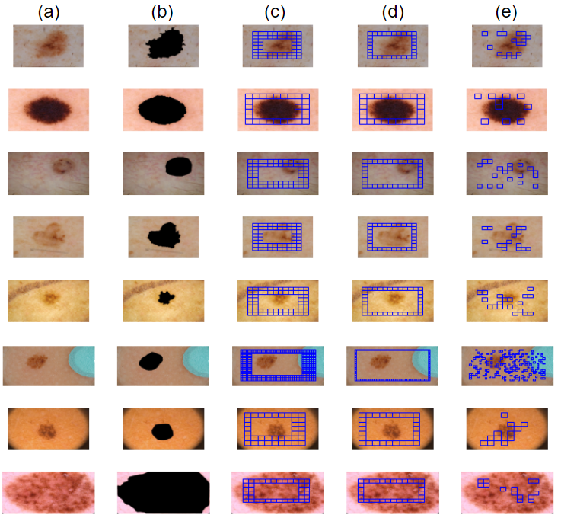
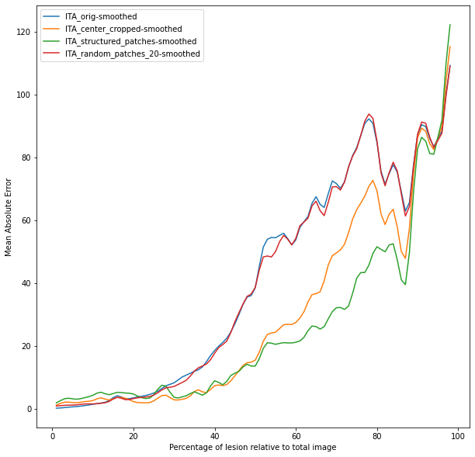
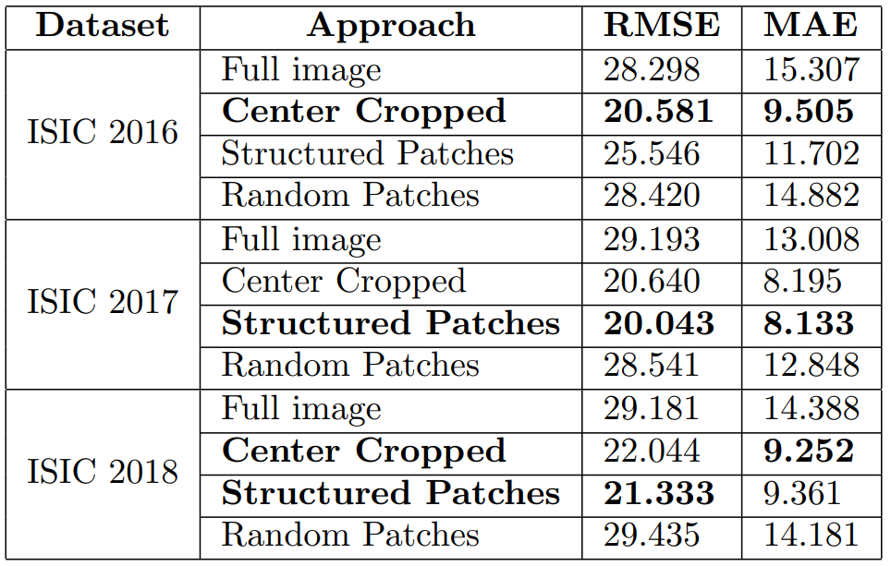
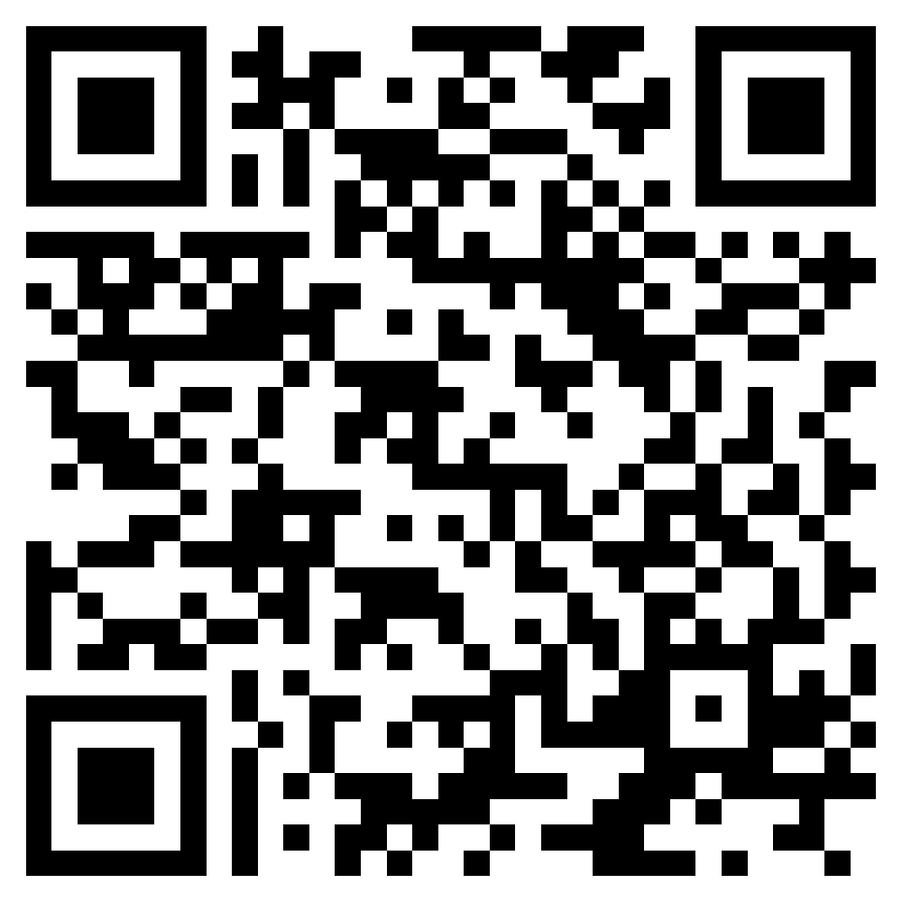
Strategies for computing Fitzpatrick skin type to evaluate fairness in dermoscopic datasets
Adam Corbin and Oge Marques, Ph.D Florida Atlantic University, Boca Raton, FL.
BACKGROUND
EXAMPLES
EVALUATION
Problem: Most AI/ML solutions are trained on public datasets that contain limited or no metadata and might be biased towards lighter skin tones. ¹
Hypothesis: The Fitzpatrick skin type information can be automatically extracted directly from pixel values of skin lesion images without any annotation. ²
Challenge: When computing the individual typology angle (ITA), the skin lesion and dark corners of dermoscopic images can often lead to inaccurate results.
Contribution: A method for computing the patient’s Fitzpatrick skin type with reasonable accuracy from dermoscopic images of skin lesions even in the absence of masks delimiting the lesion area.
METHODS
Datasets
ISIC 2016,ISIC 2017, ISIC 2018 (with skin lesion pixel annotation). ^{3,4,5}
Approaches
Full image
Center Cropped Patches
Evaluation
Each approach was compared to ITA ground truth using Root Mean Squared Error and Mean Absolute Error
Random Patches
Ground truth ITA value computed from a masked image where the skin lesion was removed
Structured Patches
Examples of the four proposed approaches (images are from the ISIC 2016 dataset): (a) original image; (b) masked image (used as ground truth for computation of performance metrics); (c) center cropped; (d) structured patches; and (e) random patches. Each blue square in parts (c)-(e) is considered a patch of fixed size.
Evaluating MAE using ISIC 2018 as the skin lesion increases the proposed methods improve
CONCLUSION
RESULTS
The proposed strategies for automatically computing skin tone from dermoscopic images of skin lesions in the absence of masks delimiting the lesion area can provide a reliable estimate of the patient’s Fitzpatrick type.
Such information can then be used for:
Augmenting any metadata already available for the dataset
Assessing dataset imbalance relative to skin color
Evaluating fairness and bias in datasets and AI/ML models used in dermatology.
FUTURE WORK
Experimental results: lower values means better performance.
Account for different artifacts in dermoscopic images such as brightly colored stickers, pen markings, water droplets, visible backgrounds.

